Slide 1
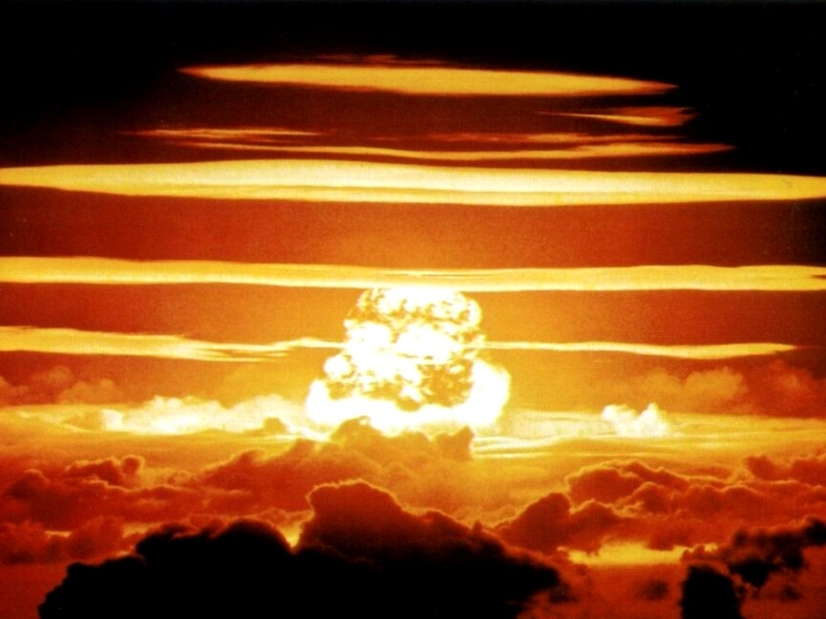
AACS 3044 Computer Game programming
Game Physics

Slide 2
Physics in games
Physics in games traditionally represents 2 segments;
  Simulation of Newtonian physics within game environment
  Collision Detection
Other elements of physics in games are particle systems which are used as part of special effects in games.

Slide 3
Vector in 2D environment
In 2D environment the grid system is represented with x and y axis.
  In direct3D, you can change the D3DXVECTOR3’s x and y property or define your own variable.
Moving up-down, left and right can be done by manipulating values of x and y of a given sprite.
However moving in an object in an angle will then require further calculation (Finally some use for your MATH)
Amount of pixels to move in y
angle
Amount of pixels to move in x

Slide 4
Calculating Vector
Amount of pixels to be moved in x and y to reach the new position can be calculated with the following formula;
Angle needs to be
radian
rad = rotation/180 * PI
Amount to move in y = cos(θ)
θ
Amount to move in x = sin(θ)
Code snippet:
Take note your grid system is an inverted grid on x axis.
Object.x += sin(θ);
Object.y += -cos(θ);

Slide 5
Modelling motion in 2D environment
In Newtonian Law of physics,
  Velocity is defined as rate of changing position which can be represented with the equation
  Acceleration is defined as the rate of changing velocity in other words it is the rate of which something speed up or slows down. It is usually represented with the equation
velocity = displacement
time interval
force = mass x acceleration

Slide 6
Representing motion in games
In 2D games velocity is can be easily represented as a variable, e.g speed.
Because games loop may be time-controlled at fix interval of 30fps, velocity is mostly constant unless there is a change in acceleration.
Source code snippet:
  float speed;
  speed = 2.0;
  Object.x += speed;
Moving in vector
  Object.x += sin(θ) * speed;
  Object.y += -cos(θ) * speed;

Slide 7
Modelling acceleration
Acceleration in 2D games are dependent on user input. This can be translated as the duration of key down or mouse down.
Acceleration should be limited by the maximum speed.
Code Snippet example:
  if (keys[DIK_UP] & 0x80)
  if(speed < MAX_SPEED)
  speed += 0.1;

Slide 8
Multilevel acceleration: modelling gearbox
Previous example represents single level acceleration. A more complex acceleration model can be adopted for games such as vehicle simulation.
In modelling multilevel acceleration, you can introduce gear as a variable to hold the level of acceleration. Changes of acceleration can then be represented as in an array and access using gear.
Gear would then be switch by user via input key.
Code Snippet:
  const int MAX_GEAR = 6;
  const int MIN_GEAR = 1;
  const int REVERSE_GEAR = 0;
  int gear = 1;
  float speed[MAX_GEAR] ={-0.1,0.5,0.4,0.25,0.1,0};
  Object.x += sin(θ) * speed[gear];
  Object.y += -cos(θ) * speed[gear];

Slide 9
Modelling deceleration (friction)
Friction is the force resisting the relative lateral motion of two solid surfaces in contact, or a solid surface in contact with a fluid (e.g. a wing in the air, or a pipe carrying water).
In 2D simulation environment, friction is always applied to slow down speed of an object.
Code Snippet Example:
  const float friction = 0.1;
  if (keys[DIK_UP] & 0x80)
  if(speed < MAX_SPEED)
  speed += 0.1;
  else
  if(speed >= MIN_SPEED && gear >= MIN_GEAR)
  speed -= friction;
  else if(speed <MIN_SPEED && gear == REVERSE_GEAR)
  speed += friction;

Slide 10
Discussion
How can we further improve on our motion techniques if we want to consider wind resistance?
How can we further improve on our motion techniques if we want to consider mass?
How can we further improve our motion technique if we want to consider gravity?
What best methods can we use when dealing with rotational forces or directions?

Slide 11
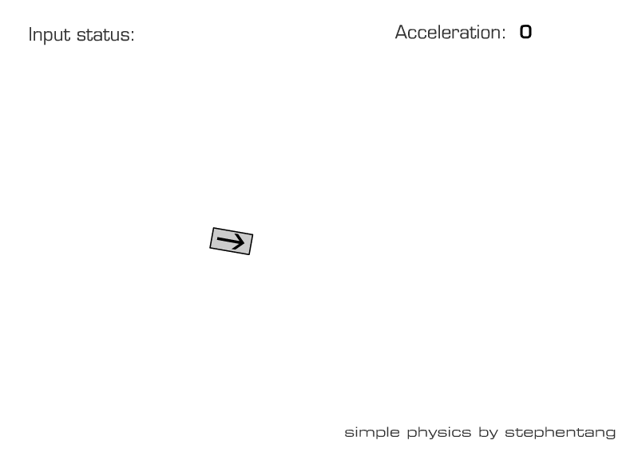

Slide 12
Working with vectors
Ultimately game physics is best modelled with vectors
Cartesian coordinate replaced with vector
Acceleration angle, x and y magnitude replaced with vector
Velocity angle, x and y magnitude replaced with vector
Acting forces angle, x and y magnitude replaced with vector
All calculations for physics done with vector math

Slide 13
Tips to modelling physics
Game Physics 101.htm
Math for game programmers 02 – Vectors 101 Higher-Order Fun.htm
Math for game programmers 03 – Geometrical representation of vectors Higher-Order Fun.htm
Math for Game Programmers 04 – Operations on vectors Higher-Order Fun.htm
Math for Game Programmers 05 – Vector Cheat Sheet Higher-Order Fun.htm

Slide 14
Game Physics
Collision Detection and response

Slide 15
Collision detection
Collision detection involves algorithms for checking for collision, i.e. intersection, of two given solids.
Two simple techniques that you already know:
  Bounding box method
  Fast collision check method

Slide 16

Bounding box
In 2D world objects are represented on screen using sprite which are essentially a rectangle consisting of bitmap image.
Can be represented with RECT structure or basic information such as height and width of the bounding box

Slide 17
Detecting collision with bounding box
Detecting collision with bounding box is essentially looking for intersection within 2 rectangles
A collision detection function would check every lines for intersection or check each edge point if it is within the area of another object.
intersection

Slide 18
Example
A simple implementation of this method, Assuming an existing sprite engine, is as follows:
// Object-to-object bounding-box collision detector:
bool Sprite_Collide(sprite_ptr object1, sprite_ptr object2) {
int left1, left2;
int right1, right2;
int top1, top2;
int bottom1, bottom2;
left1 = object1->x;
left2 = object2->x;
right1 = object1->x + object1->width;
right2 = object2->x + object2->width;
top1 = object1->y;
top2 = object2->y;
bottom1 = object1->y + object1->height;
bottom2 = object2->y + object2->height;
if (bottom1 < top2) false;
if (top1 > bottom2) false;
if (right1 < left2) false;
if (left1 > right2) false;
return true;
};

Slide 19

Issue with bounding box collision detection
Bounding box can also trigger false collision in which the actual character has not “hit” anything yet but collision is already triggered.
Instead of using one bounding box more bounding boxes can be composed to minimize false collision but may introduce additional computational effort.
The size of the bounding box can also be reduced to fit the object size.
False collision area

Slide 20
Smaller bounding box
A good figure to use is 80 percent of the full bounding box of the image. First, we add four new fields to the sprite data type, called col_width, col_height, col_x_offset, and col_y_offset.
During initialization, wherever we are defining our sprite widths and heights, we will also calculate the col_widths and col_heights to be 20% smaller.
Then we will define the offset fields to describe where to set the bounding box relative to the object's coordinates.
This will look something like this:
  object->width = <ACTUAL BITMAP WIDTH>;
  object->height = <ACTUAL BITMAP HEIGHT>;
  object->col_width = object->width * 0.80;
  object->col_height = object->height * 0.80;
  object->col_x_offset = (object->width - object->col_width) / 2;
  object->col_y_offset = (object->height - object->col_height) / 2;

Slide 21
Rewriting collision checker
Then, we can rewrite the above Sprite_Collide() to the following:
// Object-to-object, reduced bounding-box collision detector:
bool Sprite_Collide(sprite_ptr object1, sprite_ptr object2) {
int left1, left2;
int right1, right2;
int top1, top2;
int bottom1, bottom2;
left1 = object1->x + object1->col_x_offset;
left2 = object2->x + object2->col_x_offset;
right1 = left1 + object1->col_width;
right2 = left2 + object2->col_width;
top1 = object1->y + object1->col_y_offset;
top2 = object2->y + object1->col_y_offset;
bottom1 = top1 + object1->col_height;
bottom2 = top2 + object2->col_height;
if (bottom1 < top2) return false;
if (top1 > bottom2) return false;
if (right1 < left2) return false;
if (left1 > right2) return false;
return true;
};

Slide 22
Faster collision checking method
A quicker way to check for collision is to create a circular bounding region.
Collision can be checked using the method below:
If (Radius A + Radius B) > Distance A& B
Collision detected!
Radius A
Radius B
Else
No collision
Distance between A and B

Slide 23
Quick collision checker
Assume that the Avatar class has data member of radius.
bool Avatar::hitTest(Avatar another)
{
float disX = this->x – another.x;
float disY = this->y – another.y;
float distance = sqrt((disX*disX) + (disY*disY));
if(this->radius+another.radious > distance){
return true;
}
return false;
}

Slide 24
Accurate collision - Per pixel collision
Highly accurate, at the expense of extra computational cycles
Checks to see if individual pixels of two different objects have collided
Step 1: Use bounding box or quick collision method to identify if two objects are possible candidates for collision
Step 2: Obtain the collision zone of both pictures
Step 3: Iterate through the pixels within the collision zone of both sprites in tandem
Step 4: Return collision IF AND ONLY IF in the iteration there is a pair of pixels where both are non-transparent (via alpha channel or colour key)

Slide 25
Collision response
Collision response is an event where a response is generated for the collision.
It is a separate problem from collision detection!
As with collision detection, collision response can also become very complex if a high level of reliability and accuracy is desired.
Sample issue:
  If there are two objects moving towards each other who should updates who’s data?
    Rule of thumbs- each of the moving items should be doing their collision checking routine.

Slide 26
Collision response
Basic types of responses
Stop
    One or more objects may be forced to stop its movement on collision
    Example: car collides with wall
Deflect
    One or more objects may be caused to move in a different direction on collision
    Example: ball collides with other balls
Update game data
    One or more objects may need to update their attributes on collision
    Example: reduction of character hitpoints
Deformation of objects
    One or more object’s shape may need to change
    Example: terrain damage in worms series of games
Non-physical responses such as sound and animations (not considered here)

Slide 27
Example of collision response
//--- inside game loop routine
//--input
//--physics
//checking with wall
//assuming hitTest is overloaded
for(int i = 0; i < MAX_WALL; i++)
{
if(avatar.hitTest(wall[i]))
{
avatar.speed = 0;
}
}
//graphics rendering
avatar.render();
...

Slide 28
Example of collision response
//--- inside game loop routine
//--input
//--physics
if(avatar.speed > 0) //Applying friction
{
avatar.speed -= friction;
}
else if(avatar.speed < 0)
{
avatar.speed -= -friction;
}
//checking with obstacles and deflecting and updating game data
//assuming hitTest is overloaded
for(int i = 0; i < MAX_OBSTACLES; i++)
{
if(avatar.hitTest(obstacles[i]))
{
avatar.speed += -5; // this would deflect and rebound the character
avatar.health -= 5;
if(avatar.health <= 0){
avatar.health = 0;
game.state = GAMEOVER;
break;
}
}
}
//graphics rendering
avatar.render();
...

Slide 29
DISCUSSION
What if an object’s velocity is too fast, allowing it to bypass collision checking?
On detecting a collision, if two objects are already intersecting could there be errors in the collision response?
What about collision with unpredictable shapes
What about collision with objects that are rotated?
How do we know which side was collided with?

Slide 30
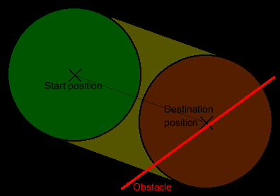
Discussion
What if an object’s velocity is too fast, allowing it to bypass collision checking?
Swept collision detection can be a solution
    Instead of checking collision using only the object, project the along it’s movement path to create a larger volume, and collide with this volume
    Weakness : if other forces such as gravity are affecting the objects motion, the sweeping projection can be problematic
Force game mechanics to be reasonable
Increase time granulity of collision checks
    Check for collision more often.

Slide 31
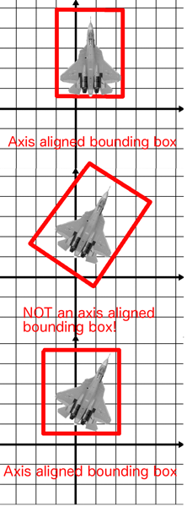
Discussion
What if an object is rotated?
Non Axis Aligned Bounding Boxes can be a solution
    Rotate the bounding box together with the object
    Weakness : Collision algorithm becomes much more complex

Slide 32
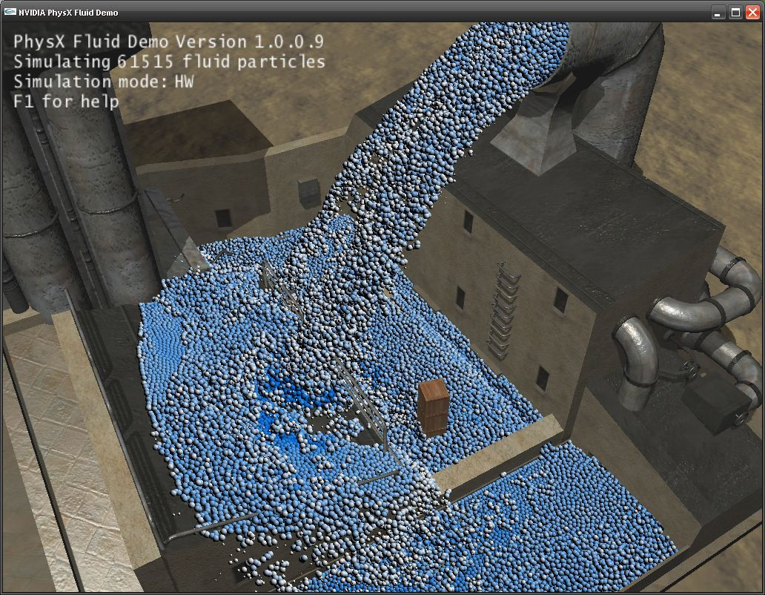
Game physics
Optimization of resources

Slide 33
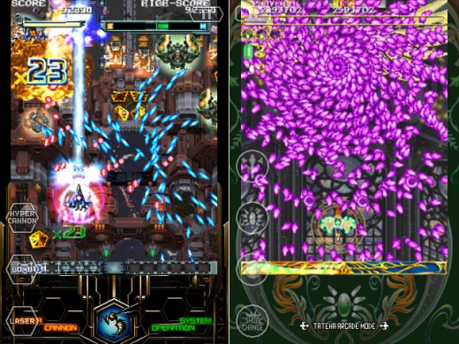
What if you have thousands of moving objects?

Slide 34
Prioritising collision checking on viewpoint
//--- inside game loop routine
//--input
//--physics
//checking with obstacles and deflecting and updating game data
//assuming hitTest is overloaded
for(int i = 0; i < MAX_ACTOR; i++)
{
if(actor[i].x > 0 &&
actor[i].x < MAX_X_SCREEN &&
actor[i].y > 0 &&
actor[i].y < MAX_Y_SCREEN)
{
//do collision detection routine
}
}
//graphics rendering
avatar.render();
...

Slide 35
More tips on optimising physics routine
Physics routine can be really expensive on processing. Some of the ways to optimise the physics is to;
  Have a routine for each type, location and etc.
    E.g. Run physics on collision detection every 5th frame if it is out of sight.
    E.g. Run physics on collision detection every frame if item is moving
Physics routine optimisation varies from different types of games.
  Eg. Car simulation might have off screen AI car not doing much collision detection.

Slide 36
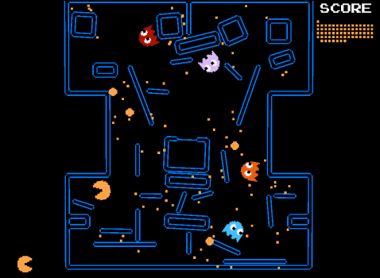
GAME PHYSICS
Further development

Slide 37
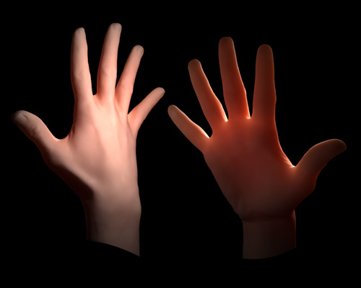
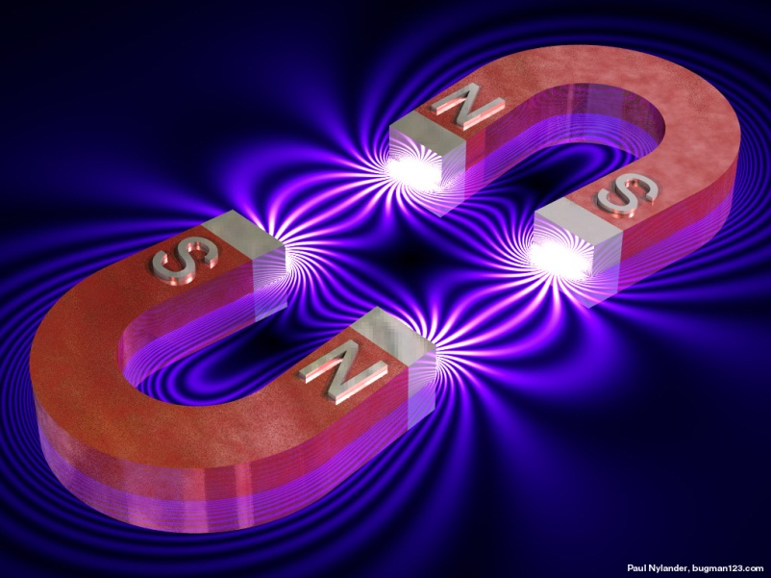
Other areas of physics
Gravity
Wind
Air and water resistance
Friction (addition of grip)
Fluid dynamics
Magnetism
Doppler effects
Cloth
Hair
Subsurface scattering
Fire
Smoke and particle effects
Destructable materials and terrain
Lighting (volumetric, shadows, dynamic)

Slide 38
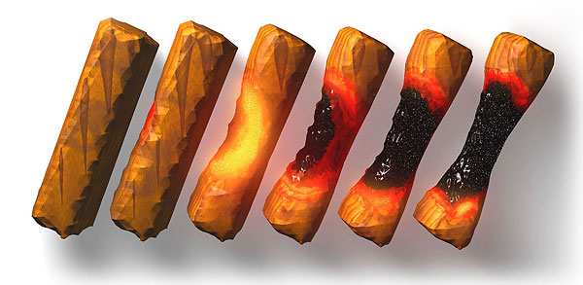
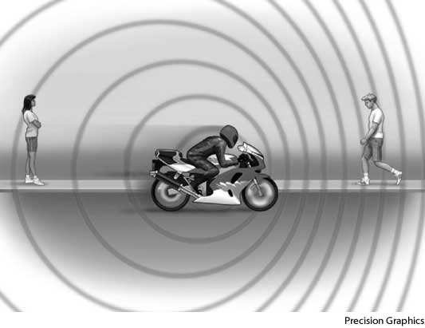
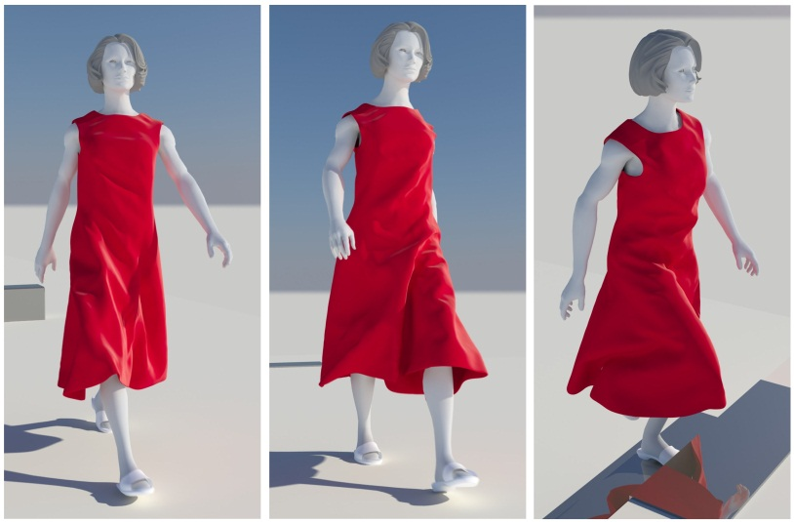
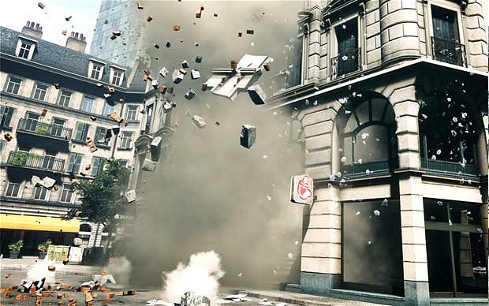
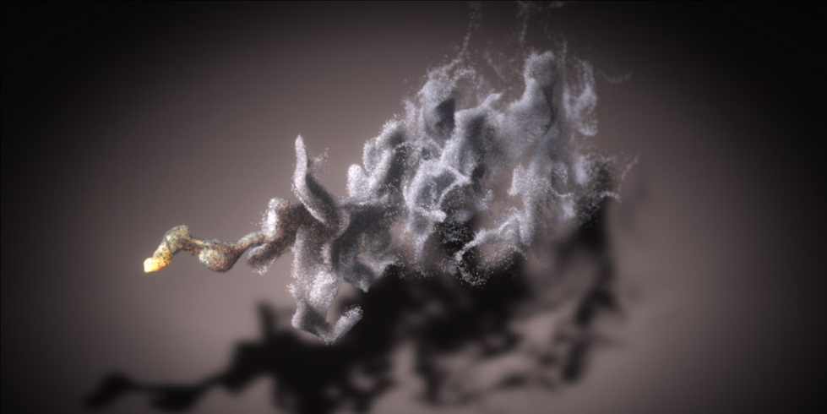

Slide 39
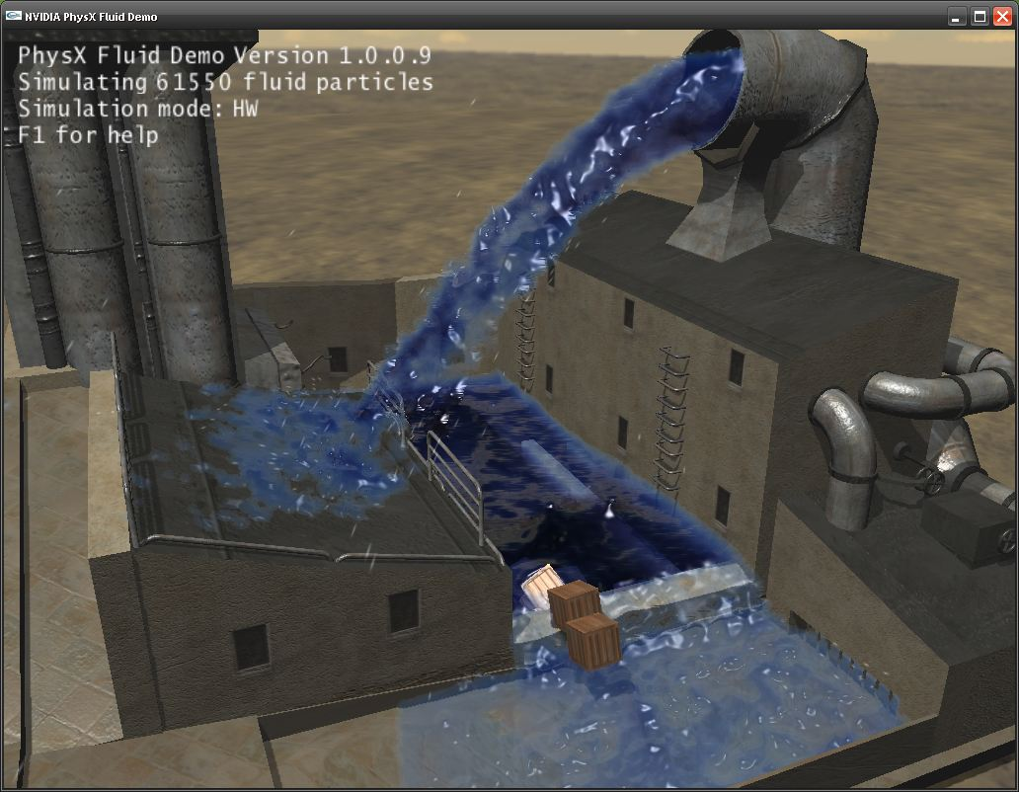
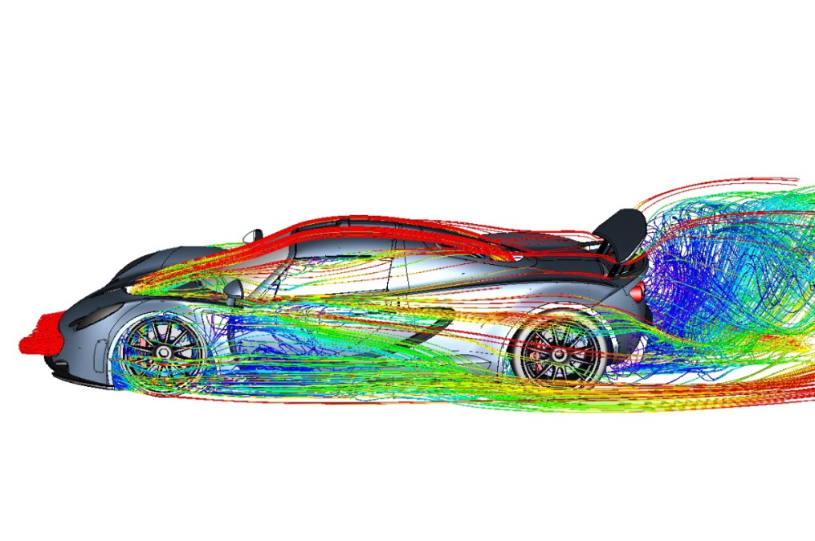
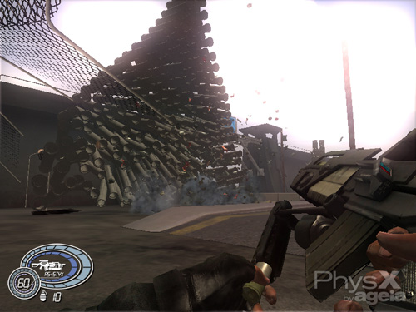
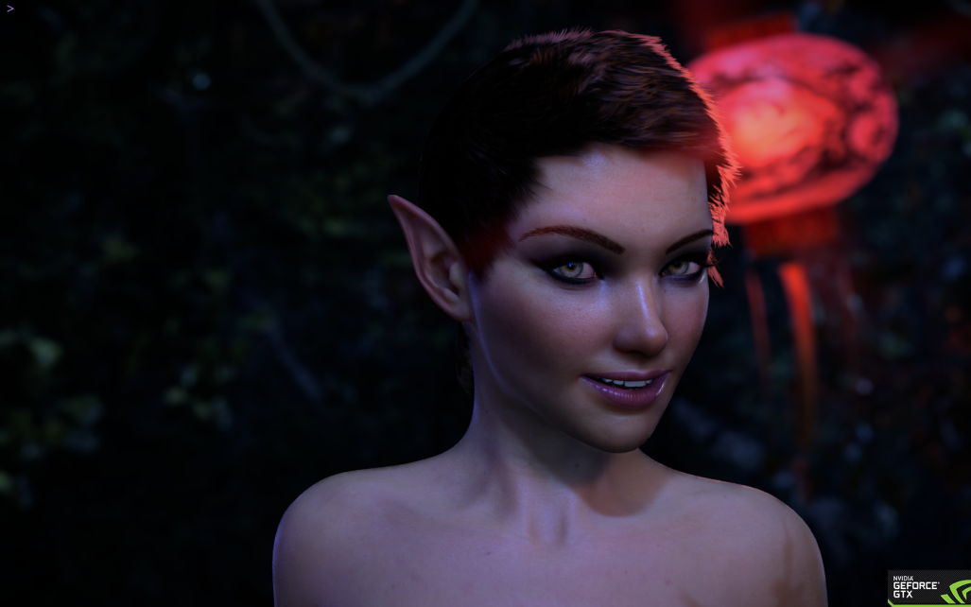

Slide 40
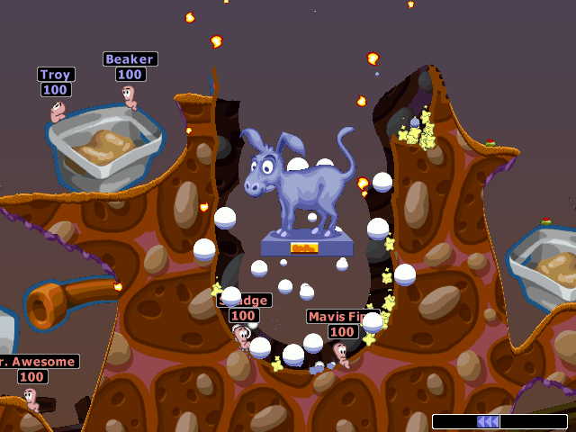

Slide 41
Nvidia - Physx
Allows real-time animation of objects reacting in realistic physical behaviour
In example, the animation for the destruction of a box in a game can be computed, modelled and rendered in real time as opposed to pre-rendering
Creates unique visuals every time
Real time computation of such animation is very processor cycle heavy
NVIDIA –PHYSX offloads the physics processing from our regular CPU and uses part of the hundreds of processing cores on the GPU to perform the processing
This delivers rich, immersive physical gaming environments with features such as:
Explosions that create dust and collateral debris
Characters with complex, jointed geometries, for more life-like motion and interaction
Spectacular new weapons with incredible effects
Cloth that drapes and tears naturally
Dense smoke & fog that billow around objects in motion

Slide 42
Nvidia - Physx
Why is a GPU good for physics?
Multithreaded
Multi-core (2560 on the GTX 1080)
Specialize in certain instructions – less to choose from = faster

